Slide 1




Mobile Application Development
Muhammad Ashraf Baloch

Slide 2
Java Hello World First Program in Java
public class HelloWorld {
public static void main(String[] args) {
// TODO Auto-generated method stub
//System.out.println("Hello World");
}
}

Slide 3
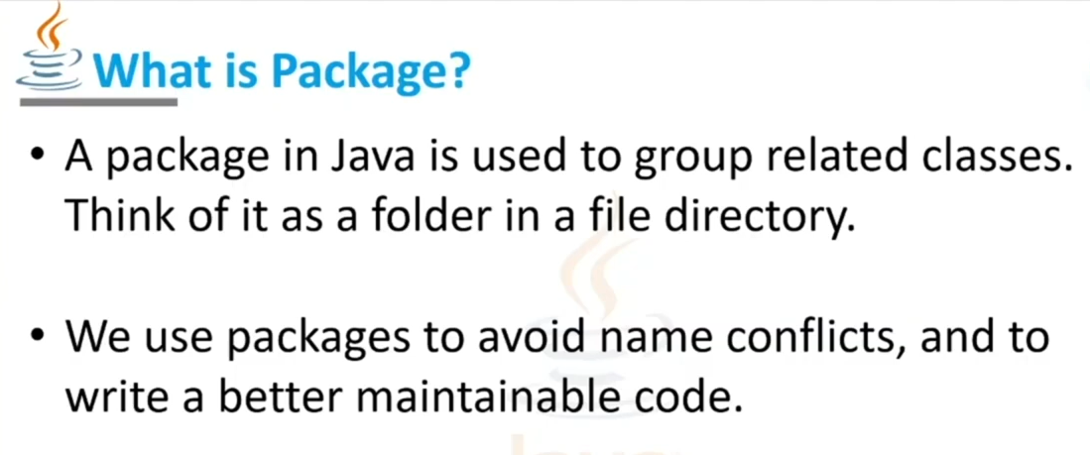

Slide 4
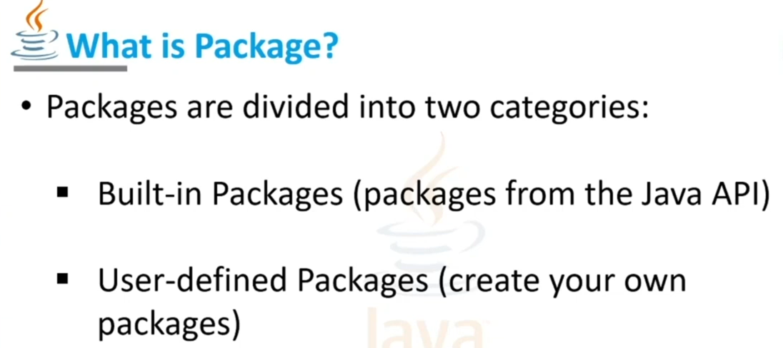

Slide 5
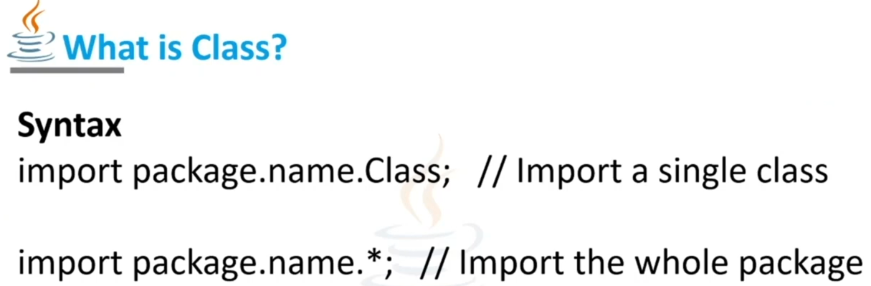

Slide 6
Classes in Java
In this page, we will learn about Java objects and classes. In object-oriented programming technique, we design a program using objects and classes.
An object in Java is the physical as well as a logical entity, whereas, a class in Java is a logical entity only.
What is an object in Java
An entity that has state and behavior is known as an object e.g., chair, bike, marker, pen, table, car, etc. It can be physical or logical (tangible and intangible). The example of an intangible object is the banking system.

Slide 7
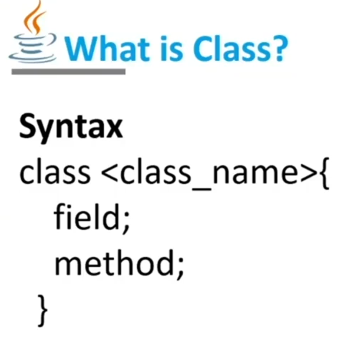

Slide 8
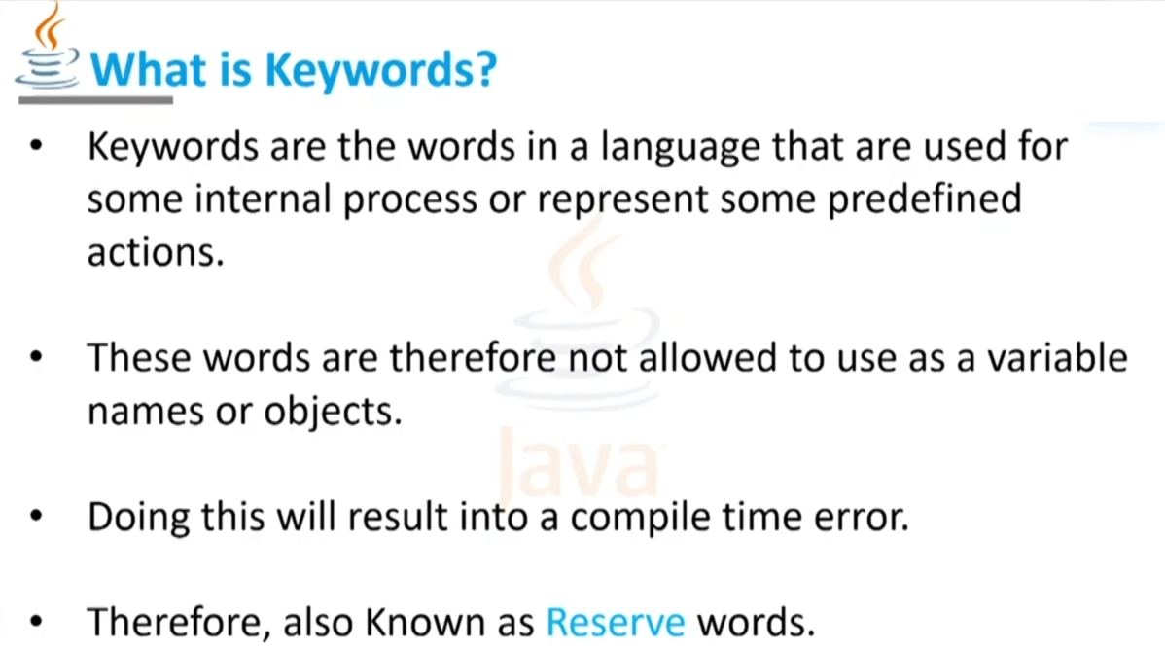
Keyword and Identifiers

Slide 9
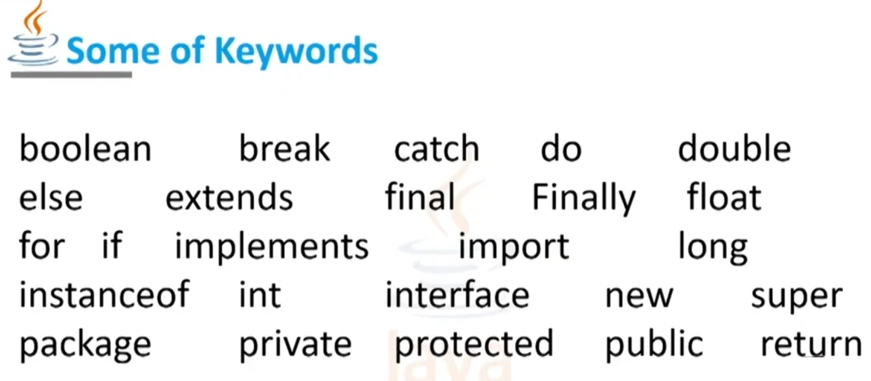

Slide 10
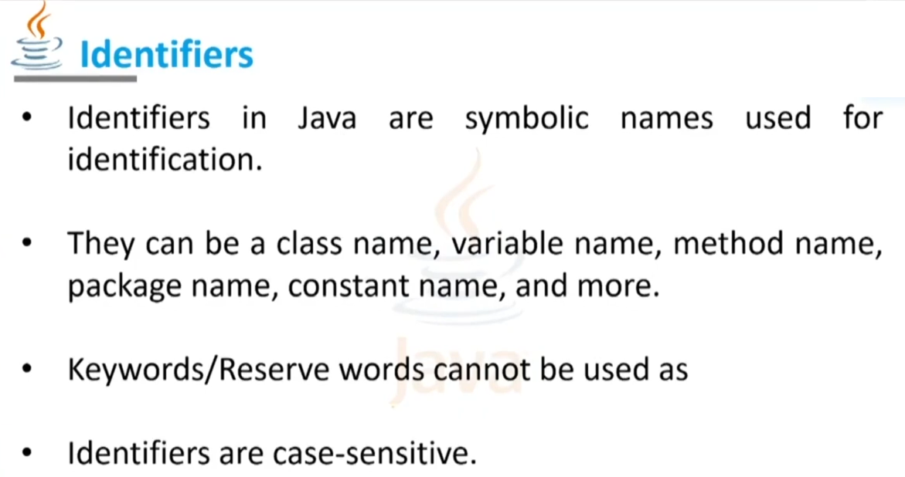

Slide 11
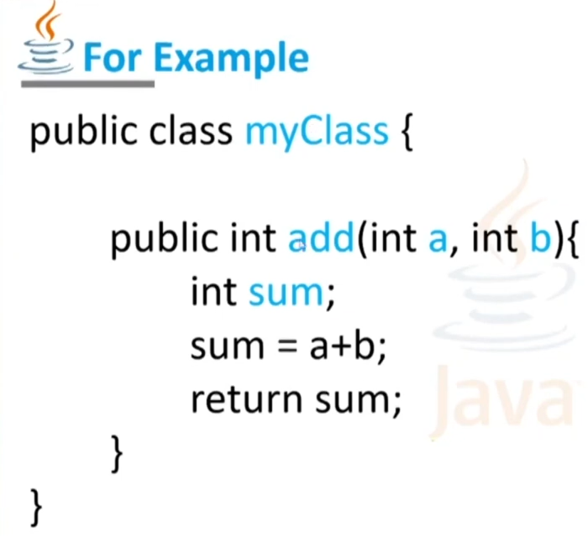

Slide 12
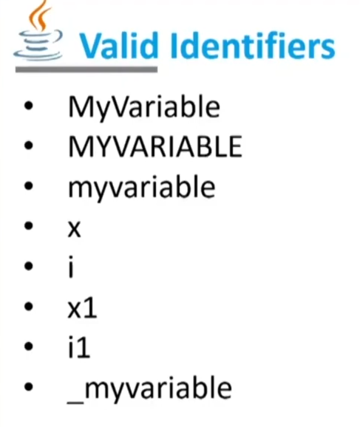

Slide 13
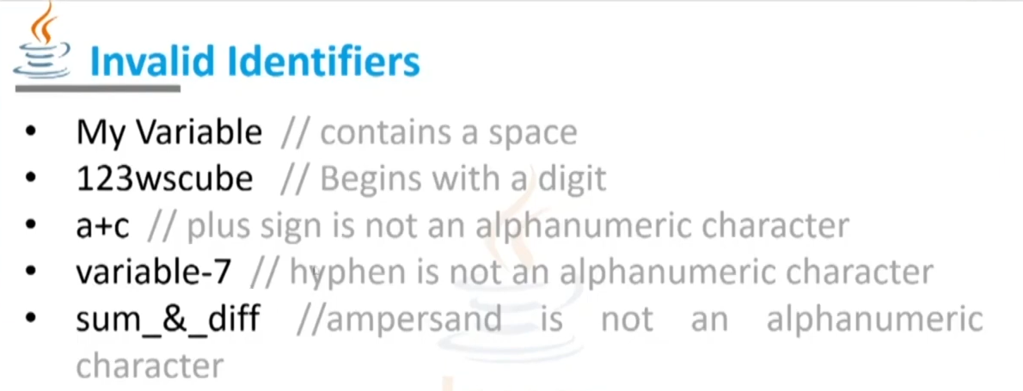

Slide 14
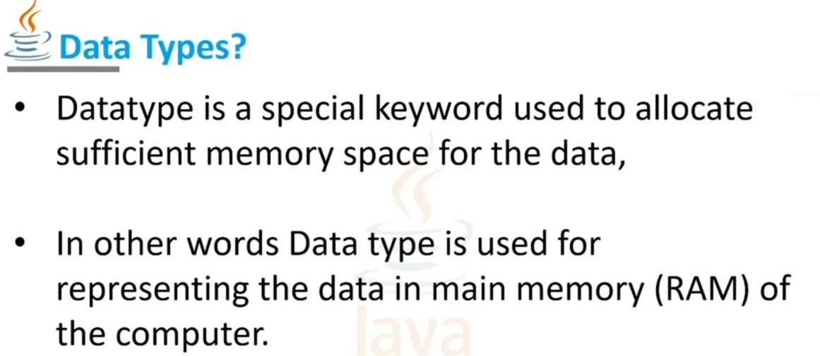

Slide 15
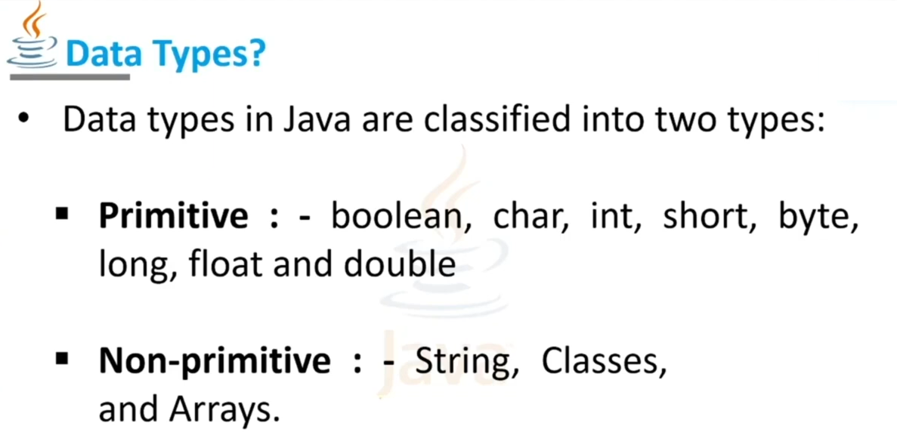
Interfaces

Slide 16
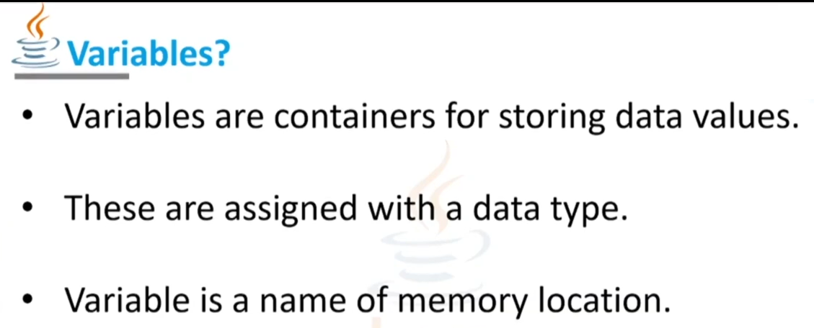

Slide 17
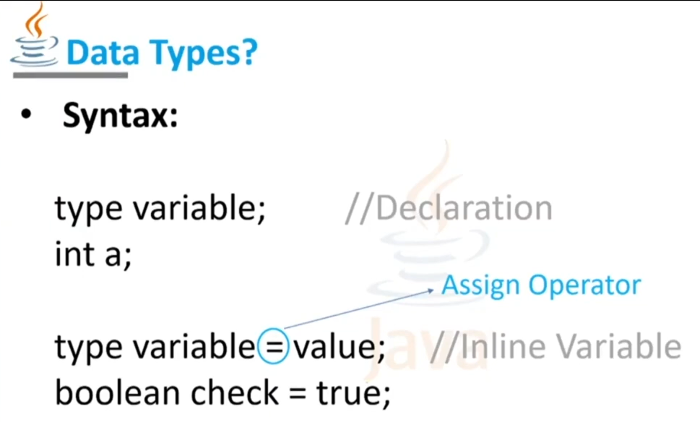

Slide 18
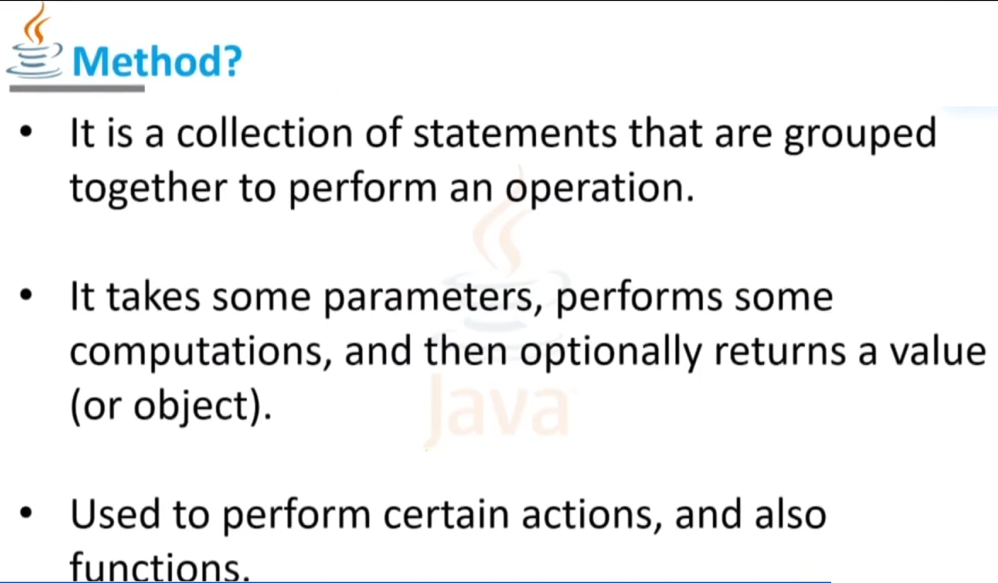
Known as

Slide 19
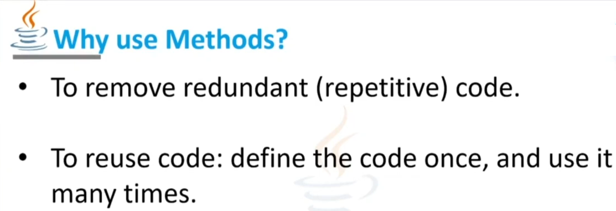
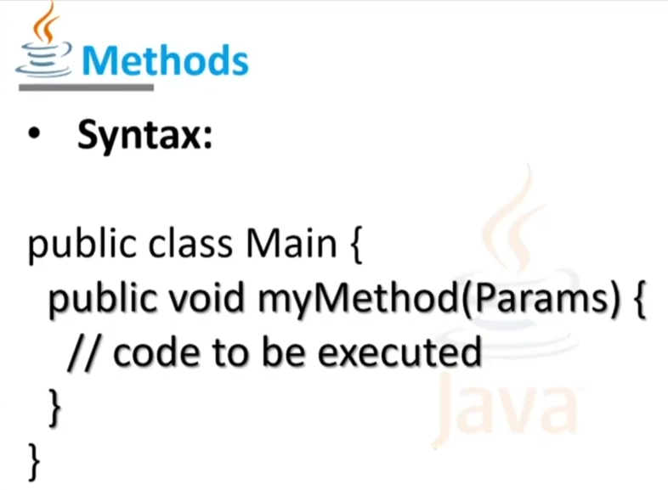
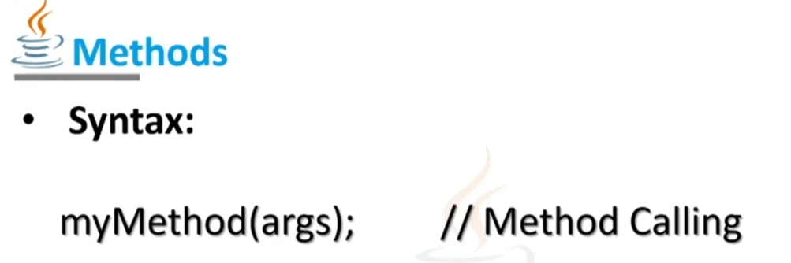

Slide 20

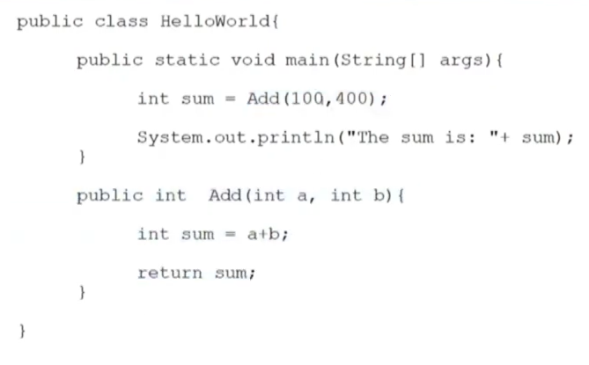

Slide 21
How to get input from user in Java
import java.util.*;
public class Hello{
public static void main(String[] args) {
Scanner reader = new Scanner(System.in); // Reading from System.in
System.out.println("Enter a number: ");
int n = reader.nextInt();
System.out.println("You Enter : " + n);
}
}

Slide 22
Java OOPs Concepts
In this page, we will learn about the basics of OOPs. Object-Oriented Programming is a paradigm that provides many concepts, such as inheritance, data binding, polymorphism, etc.
Simula is considered the first object-oriented programming language. The programming paradigm where everything is represented as an object is known as a truly object-oriented programming language.
Smalltalk is considered the first truly object-oriented programming language.
The popular object-oriented languages are Java, C#, PHP, Python, C++, etc.

Slide 23
Java OOPs Concepts…
The main aim of object-oriented programming is to implement real-world entities, for example, object, classes, abstraction, inheritance, polymorphism, etc.
OOPs (Object-Oriented Programming System)
Object means a real-world entity such as a pen, chair, table, computer, watch, etc. Object-Oriented Programming is a methodology or paradigm to design a program using classes and objects. It simplifies software development and maintenance by providing some concepts:

Slide 24
Java OOPs Concepts…
Object
Class
Inheritance
Polymorphism
Abstraction
Encapsulation
Apart from these concepts, there are some other terms which are used in Object-Oriented design:
Coupling
Cohesion
Association
Aggregation
Composition

Slide 25
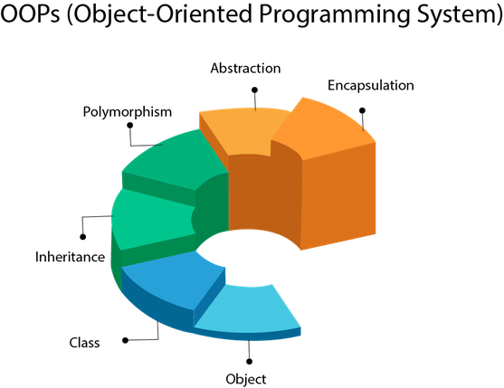

Slide 26
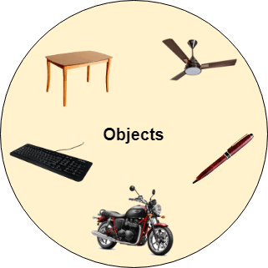
Java OOPs Concepts…
Objects
Any entity that has state and behavior is known as an object. For example, a chair, pen, table, keyboard, bike, etc. It can be physical or logical.
An Object can be defined as an instance of a class. An object contains an address and takes up some space in memory. Objects can communicate without knowing the details of each other's data or code. The only necessary thing is the type of message accepted and the type of response returned by the objects.
Example: A dog is an object because it has states like color, name, breed, etc. as well as behaviors like wagging the tail, barking, eating, etc.

Slide 27
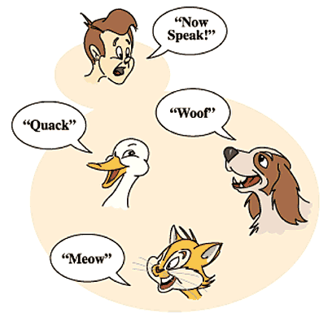
Java OOPs Concepts…
Class
Collection of objects is called class. It is a logical entity.
A class can also be defined as a blueprint from which you can create an individual object. Class doesn't consume any space.
Inheritance
When one object acquires all the properties and behaviors of a parent object, it is known as inheritance. It provides code reusability. It is used to achieve runtime polymorphism.
Polymorphism
If one task is performed in different ways, it is known as polymorphism. For example: to convince the customer differently, to draw something, for example, shape, triangle, rectangle, etc.
In Java, we use method overloading and method overriding to achieve polymorphism.
Another example can be to speak something; for example, a cat speaks meow, dog barks woof, etc

Slide 28

Java OOPs Concepts…
Abstraction
Hiding internal details and showing functionality is known as abstraction. For example phone call, we don't know the internal processing.
In Java, we use abstract class and interface to achieve abstraction.
Encapsulation
Binding (or wrapping) code and data together into a single unit are known as encapsulation. For example, a capsule, it is wrapped with different medicines.
A java class is the example of encapsulation. Java bean is the fully encapsulated class because all the data members are private here.

Slide 29
Inheritance
class Main
{
public static void main(String[] args)
{
// create an object of the subclass
Dog labrador = new Dog();
// access field of superclass
labrador.name = "Rohu";
labrador.display();
// call method of superclass
// using object of subclass
labrador.eat();
}
}
Class PetAnimal {
// field and method of the parent class
String name;
public void eat()
{
System.out.println("I can eat");
} }
// inherit from PetAnimal class
Dog extends PetAnimal
{
// new method in subclass
public void display()
{
System.out.println("My name is " + name);
} }

Slide 30
Java Polymorphism
Polymorphism is an important concept of object-oriented programming. It simply means more than one form.
That is, the same entity (method or operator or object) can perform different operations in different scenarios.
class Circle extends Polygon {
// renders circle
public void render() {
System.out.println("Rendering Circle...");
}
}
class Main {
public static void main(String[] args) {
// create an object of Square
Square s1 = new Square();
s1.render();
// create an object of Circle
Circle c1 = new Circle();
c1.render();
}}
class Polygon {
// method to render a shape
public void render() {
System.out.println("Rendering Polygon...");
}
}
class Square extends Polygon {
// renders Square
public void render() {
System.out.println("Rendering Square...");
}
}

Slide 31
Java Polymorphism..
Java Method Overriding with TypeCast
During inheritance in Java, if the same method is present in both the superclass and the subclass. Then, the method in the subclass overrides the same method in the superclass. This is called method overriding.
In this case, the same method will perform one operation in the superclass and another operation in the subclass. For example,
class Language {
public void displayInfo() {
// TODO Auto-generated method stub
System.out.println("Language");
}
}
class Java extends Language {
public void displayInfo() {
System.out.println("Java Language");
}
}
public class MainPolygon {
public static void main(String[] args) {
// create an object of Java class
Language j1 = new Java();
j1.displayInfo();
// create an object of Language class
// Language l1 = new Language();
// l1.displayInfo();
}
}

Slide 32
Java Polymorphism..
Java Method Overloading
In a Java class, we can create methods with the same name if they differ in parameters. For example,
class Pattern {
// method without parameter
public void display() {
for (int i = 0; i < 10; i++) {
System.out.print("*");
}
}
// method with single parameter
public void display(char symbol) {
for (int i = 0; i < 10; i++) {
System.out.print(symbol);
}
}
}
class Main {
public static void main(String[] args) {
Pattern d1 = new Pattern();
// call method without any argument
d1.display();
System.out.println("\n");
// call method with a single argument
d1.display('#');
}
}
Output:
**********
##########

Slide 33
Java Polymorphism..
Java Operator Overloading
Some operators in Java behave differently with different operands. For example,
+ operator is overloaded to perform numeric addition as well as string concatenation, and
operators like &, |, and ! are overloaded for logical and bitwise operations.
Let's see how we can achieve polymorphism using operator overloading.
The + operator is used to add two entities. However, in Java, the + operator performs two operations.
1. When + is used with numbers (integers and floating-point numbers), it performs mathematical addition. For example,
int a = 5;
int b = 6;
// + with numbers
int sum = a + b; // Output = 11
String first = "Java ";
String second = "Programming";
// + with strings
name = first + second; // Output = Java Programming

Slide 34
Abstraction
1. What is Abstraction?
Abstraction is the process of hiding the internal details of an application from the outer world. Abstraction is used to describe things in simple terms. It’s used to create a boundary between the application and the client programs.
2. Abstraction in Real Life
Abstraction is present in almost all the real life machines.
Your car is a great example of abstraction. You can start a car by turning the key or pressing the start button. You don’t need to know how the engine is getting started, what all components your car has. The car internal implementation and complex logic is completely hidden from the user.
We can heat our food in Microwave. We press some buttons to set the timer and type of food. Finally, we get a hot and delicious meal. The microwave internal details are hidden from us. We have been given access to the functionality in a very simple manner.

Slide 35
Abstraction..
Abstraction in OOPS
Objects are the building blocks of Object-Oriented Programming. An object contains some properties and methods. We can hide them from the outer world through access modifiers. We can provide access only for required functions and properties to the other programs. This is the general procedure to implement abstraction in OOPS.
What are the different types of abstraction?
There are two types of abstraction.
Data Abstraction
Process Abstraction
1) Data Abstraction
When the object data is not visible to the outer world, it creates data abstraction. If needed, access to the Objects’ data is provided through some methods.

Slide 36
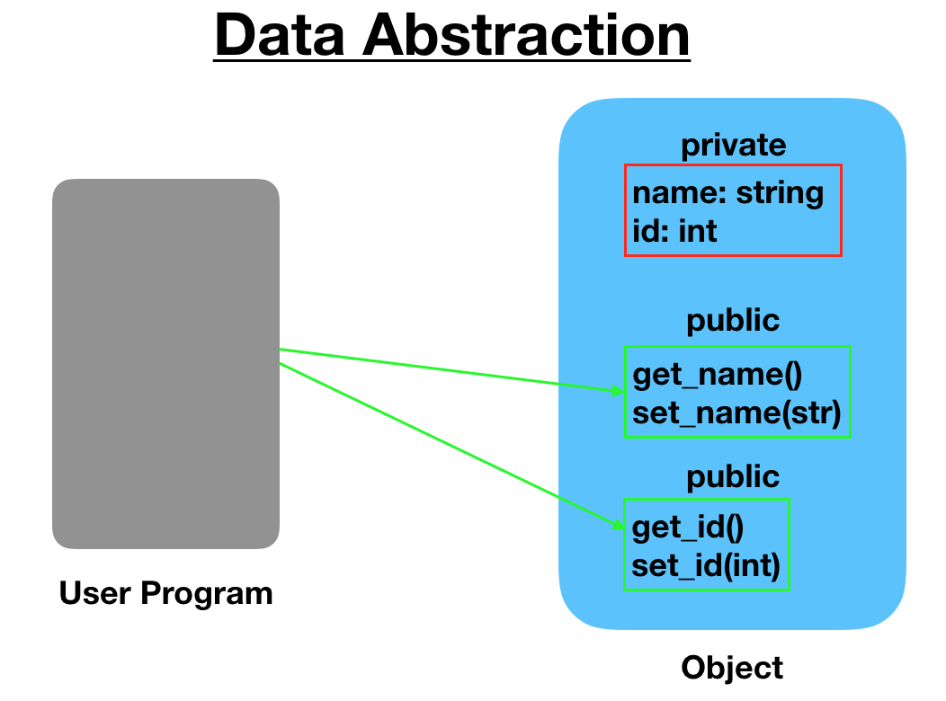
Abstraction..

Slide 37
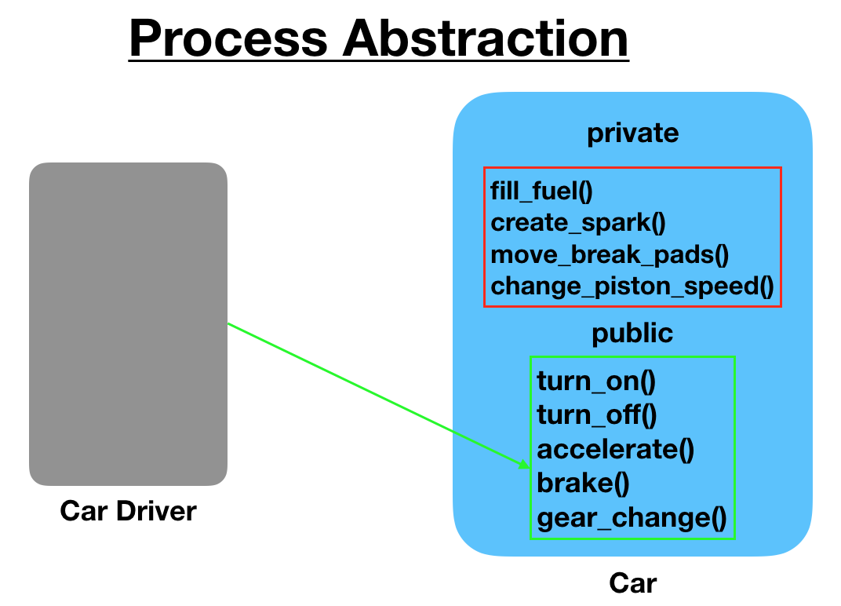
Abstraction..
2) Process Abstraction
We don’t need to provide details about all the functions of an object. When we hide the internal implementation of the different functions involved in a user operation, it creates process abstraction.

Slide 38
Abstraction..
ManualCar.java, AutomaticCar.java: implementation classes of Car.
public class ManualCar implements Car {
private String carType = "Manual";
@Override
public void turnOnCar() {
System.out.println("turn on the manual car");
}
@Override
public void turnOffCar() {
System.out.println("turn off the manual car");
}
@Override
public String getCarType() {
return this.carType;
}
}
public interface Car {
void turnOnCar();
void turnOffCar();
String getCarType();
}

Slide 39
Abstraction..
public class CarTest {
public static void main(String[] args) {
Car car1 = new ManualCar();
Car car2 = new AutomaticCar();
car1.turnOnCar();
car1.turnOffCar();
System.out.println(car1.getCarType());
car2.turnOnCar();
car2.turnOffCar();
System.out.println(car2.getCarType());
}
}
public class AutomaticCar implements Car {
private String carType = "Automatic";
@Override
public void turnOnCar() {
System.out.println("turn on the automatic car");
}
@Override
public void turnOffCar() {
System.out.println("turn off the automatic car");
}
@Override
public String getCarType() {
return this.carType;
}
}

Slide 40
Java Encapsulation
Encapsulation is one of the key features of object-oriented programming. Encapsulation refers to the bundling of fields and methods inside a single class.
It prevents outer classes from accessing and changing fields and methods of a class. This also helps to achieve data hiding.
class Person {
// private field
private int age;
// getter method
public int getAge() {
return age;
}
// setter method
public void setAge(int age) {
this.age = age;
}
}
class Main {
public static void main(String[] args) {
// create an object of Person
Person p1 = new Person();
// change age using setter
p1.setAge(24);
// access age using getter
System.out.println("My age is " + p1.getAge());
}
}

Slide 41
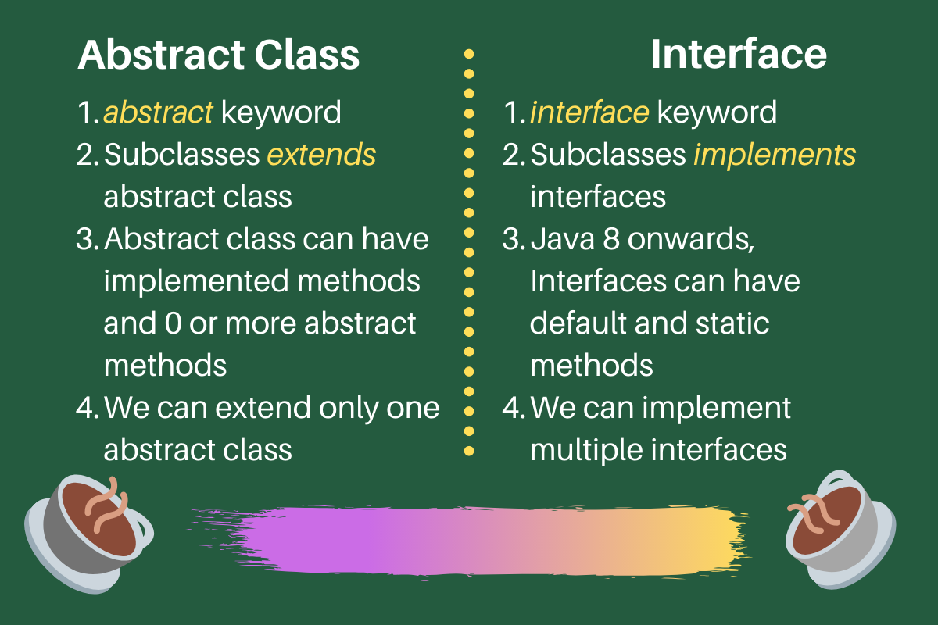
Abstract classes can have methods with implementation whereas interface provides absolute abstraction and can’t have any method implementations. Note that from Java 8 onwards, we can create default and static methods in interface that contains the method implementations

Slide 42
Getters and Setters
public int getMonth() {
return month;
}
public void setMonth(int month) {
this.month = month;
}
public int getYear() {
return year;
}
public void setYear(int year) {
this.year = year;
}
@Override
public String toString() {
return "Date [getDay()=" + getDay() + ", getMonth()=" + getMonth() + ", getYear()=" + getYear() + "]";
}
}
public class Date {
private int day;
private int month;
private int year;
public Date() {}
public Date(int day, int month, int year) {
super();
this.day = day;
this.month = month;
this.year = year;
}
public int getDay() {
return day;
}
public void setDay(int day) {
this.day = day;
}

Slide 43
Getters and Setters …
public class simple {
public static void main(String[] args) {
// TODO Auto-generated method stub
//System.out.println("Hello World");
Date obj = new Date(01, 02, 2023);
System.out.print("Date " + obj.toString());
}
}

Slide 45
class Animal{
public static void Eat()
{
System.out.println("Animal Can Eat");
}
}
class PetAnimal extends Animal{
public static void DisplayInfo()
{
System.out.println("1.Dog\n2.Cat");
}
}
class PetAnimals extends PetAnimal{
public static void DisplayInfo()
{
System.out.println("3.Horse\n4.Parrot");
}
}
public class MainClass {
public static void main(String[] args) {
// TODO Auto-generated method stub
// System.out.print("Hello world");
PetAnimals obj = new PetAnimals();
obj.DisplayInfo();
}
}

Slide 46
import java.util.*;
public class HelloWorld {
public static void main(String[] args) {
// TODO Auto-generated method stub
/*
System.out.println("Hello world");
Scanner reader = new Scanner(System.in); // Reading from System.in
System.out.println("Enter a number: ");
int n = reader.nextInt();
System.out.println("You Enter : " + n);
*/
// Dog Lab= new Dog();
// Dog Lab1 = new Dog();
// Lab.eat();
// Lab.eat();
// declaring and initializing an array
int[] myArray = { 2, 3, 4, 5, 6 };
// print array element at index 0
System.out.println("Before change myArray[0]: " + myArray[0]);
// changing the array element
myArray[0] = 1;
// print array element at index 0
System.out.println("After change myArray[0]: " + myArray[0]);
}
}
class PetAnimal {
// field and method of the parent class
String name;
public void eat()
{
System.out.println("Parent Eat");
//int a,b,c;
//a=2;b=3;
//c=a+b;
String a="Ali";
String b="Imran";
String c=a+b;
System.out.println("Result OverLoad = "+ c);
Car car1 = new ManualCar();
car1.turnOnCar();
car1.turnOffCar();
System.out.println(car1.getCarType());
}
}

Slide 47
class Dog extends PetAnimal
{
/*
public void eat()
{
System.out.println("Child Eat");
}
*/
}
/*
interface Car {
void turnOnCar();
void turnOffCar();
String getCarType();
}
class ManualCar implements Car {
private String carType = "Manual";
@Override
/*
public void turnOnCar() {
System.out.println("turn on the manual car");
}
@Override
public void turnOffCar() {
System.out.println("turn off the manual car");
}
@Override
public String getCarType() {
return this.carType;
}
}

